Slide 1

Art Curators about cultural paradigm shifts
Alicja Kutek alk36
Aberystwyth University 2019

Slide 2
Introduction
4 Curators
4 Art Projects:
3 Exhibitions
1 publication
1 Key area of interest
3 Questions

Slide 3
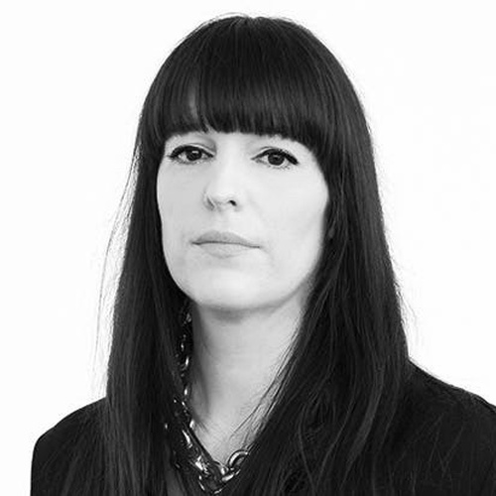
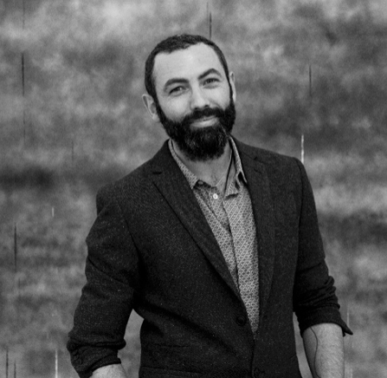
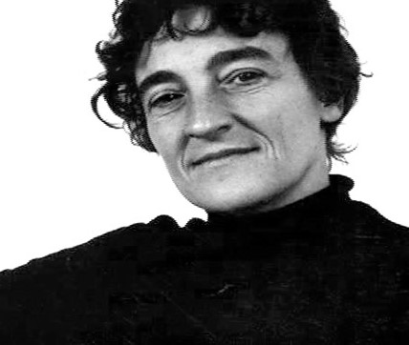
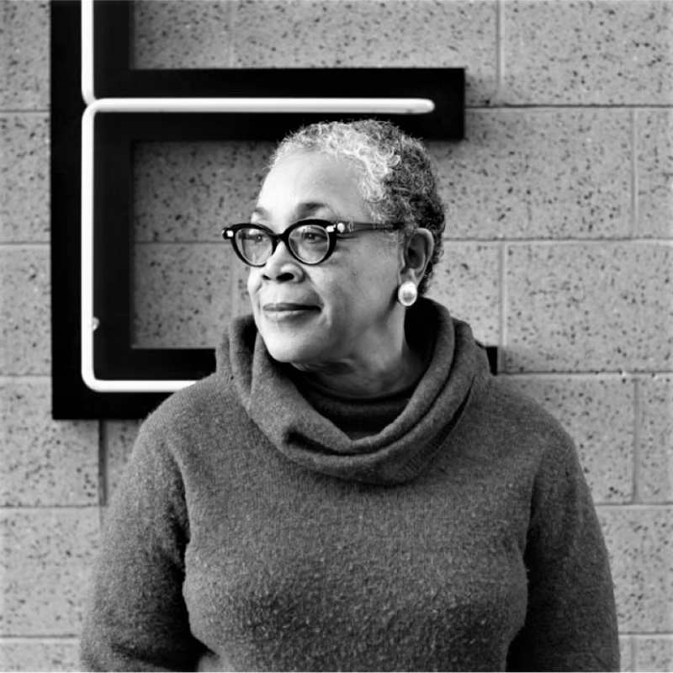
Lucy R.Lippard
Lowery Stokes Sims
Eva Respini
Vincent Honore
The Barbara Lee Chief Curator at the ICA Boston
Director and Chef Curator, writer , Independent Curator
American writer ,art critic activist and curator
Retired Curator at the museum of Arts and Design

Slide 4
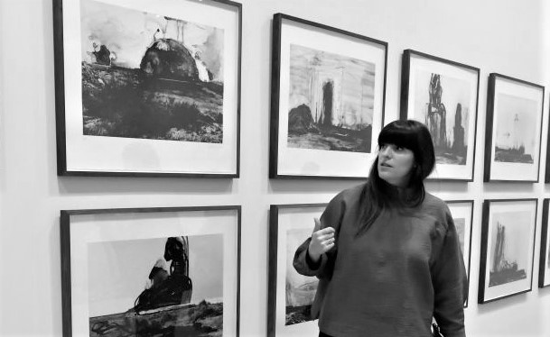
Eva Respini
Published numerous books and catalogues, museum publications
Organised numerous exhibitions of contemporary Art & Photography
Specialises in global contemporary art and image-making practices
Skills :
Curatorial Leadership
Commitment to curatorial craft at every level of exhibition-making
Traveller – all her multiple research travels gave her a unique worldview that she brings to her curatorial work
The Barbara Lee Chief Curator at the ICAI Boston (since 2015)
Used to be a curator at the Museum of Modern Art
BA & MA in Art History
Since 2014 Fellow at the Centre for Curatorial Leadership
Visiting Lecturer, critic, speaker at a numerous of universities

Slide 5
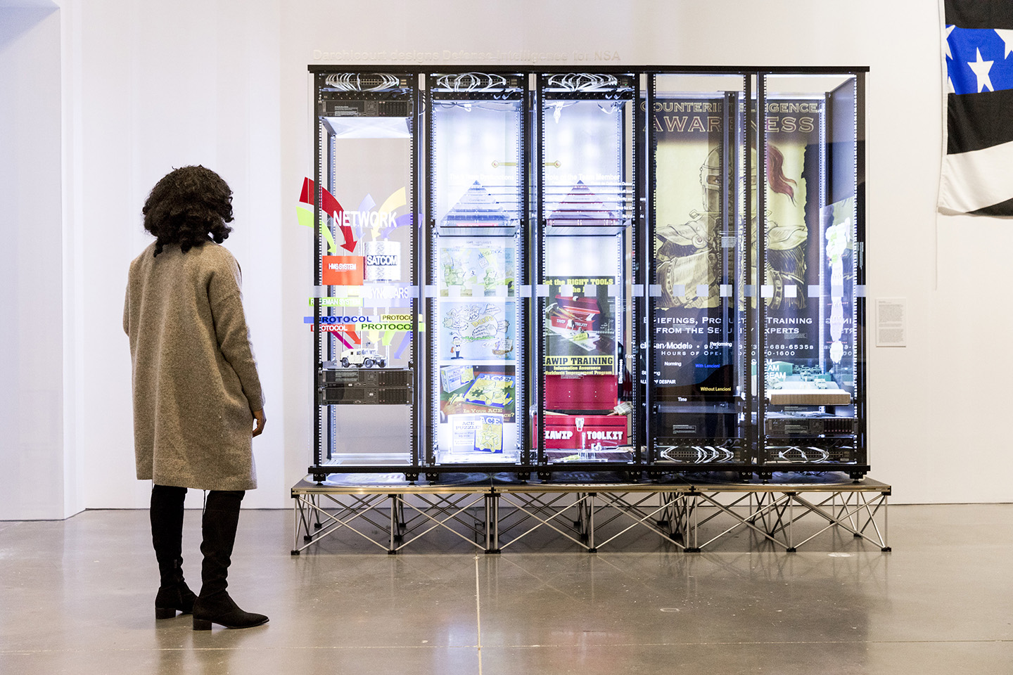
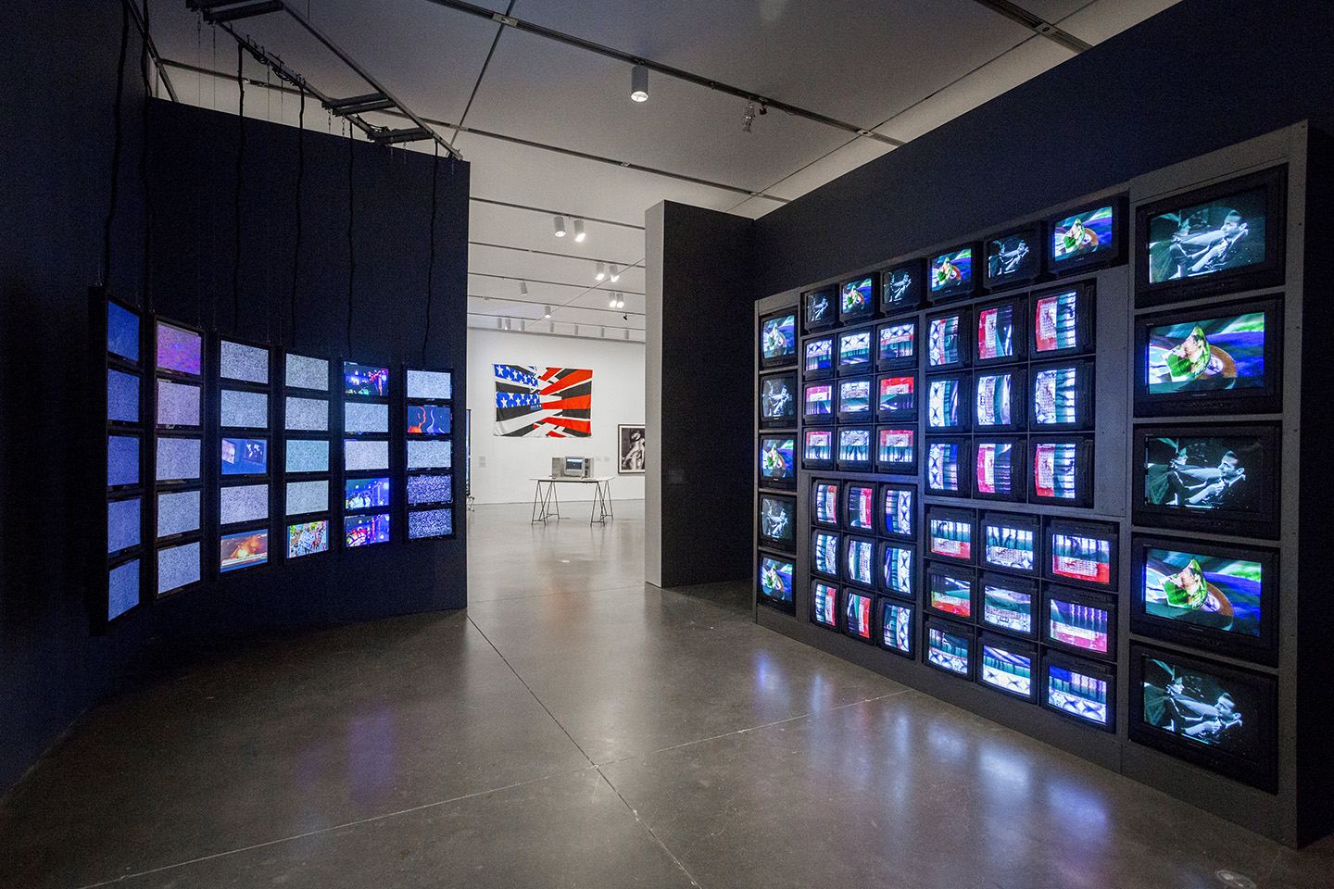
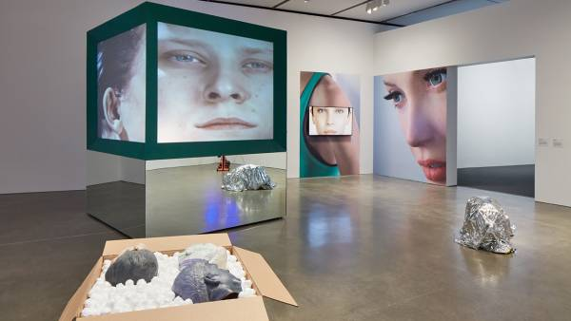
Art in the Age of the Internet , 1989 to Today
The exhibition examines how the Internet has radically changed the field of art, especially in its production, distribution, and reception
7 Feb 2018 – 20 May 2018,
At ICA Boston
All projects included in the exhibition investigate the extensive effects of the internet on artistic practise and contemporary culture
Boston is a birthplace of experiments that have structurally changed the way we live in the world
70 works, from painting to performance to virtual reality, by an international, intergenerational group of 60 artists

Slide 6
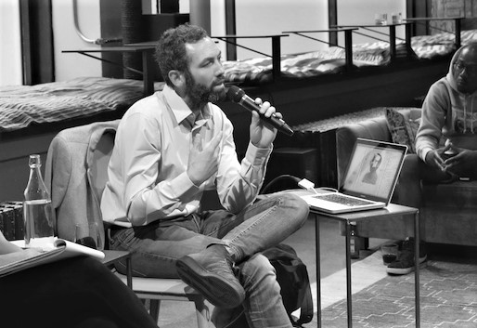
Vincent Honore
His work leaves an unforgettable impression on the world of art
Why curator?- To fully embrace contemporary Art
Favourite part about curating process:
To engage with artist
To research
To debate
To share
To produce
Contextualizing artworks
Positioning the artworks in an exhibition
Previously, he wanted to become a teacher to teach & to learn , but he quickly realised that as a curator he will still be able to learn new things
Curious Curator – Director and Chief Curator, writer, based in London and Paris
Has an experience that includes roles in the Palais de Tokyo and Tate Modern
Since October 2017 Senior Curator at Hayward Gallery in London

Slide 7

Kiss My Genders
London, Hayward Gallery, London’s Southbank Centre,
12th June 2019
till 8th September 2019
Key message from the exhibition: it is the right for the body to be subversive, mischievous, ambiguous, even illegible, demonstrating that an experience and fluid approach is both political and truly liberating
The exhibition is not addressed to the masses. When you enter, you can turn right or left or go upstairs. It creates territories and areas of discoveries.
“I think this is the first exhibition in a massive gallery in the UK which is not just about addressing queer theories, but trying to go beyond that and create a real celebration of different genders”
~ Vincent Honore
30 international artists and over 100 works –explores and celebrates gender identities and fluidity
Film
Drawing
Painting
Performance
Photography
Spanning sculpture

Slide 8

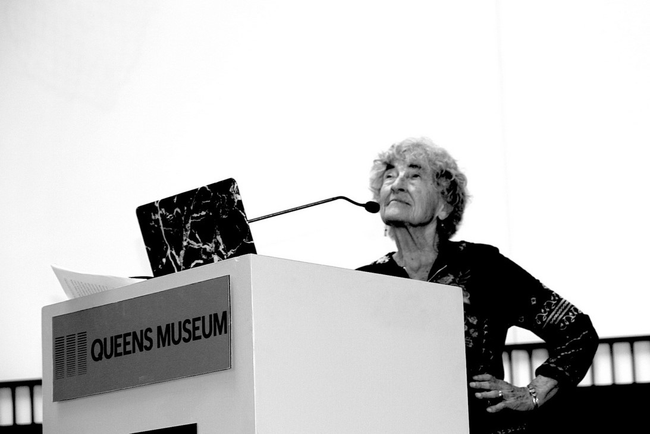
Lucy R. Lippard
She reformed the practise of curating by introducing bold concepts aimed to establish a communication with a wider audience
Lippard is constantly moving forward from the predeterminate positions of a curator to critic and vice versa
She used the feminist tool to speak about the importance of all people (artists) being labelled as the Others
American writer ,art critic activist and curator
One of the first writers to argue for the ‘dematerialization’ at work in conceptual art
Early champion of feminist art
Just out of college Lippard began to work in MoMA in library and then after BA and MA in Art History as a Curator– curated over 50 exhibitions
Sine 1966 she has published 20 books– including one novel on feminism, art, politics and peace
Most of her books on art reflect her activist politics

Slide 9


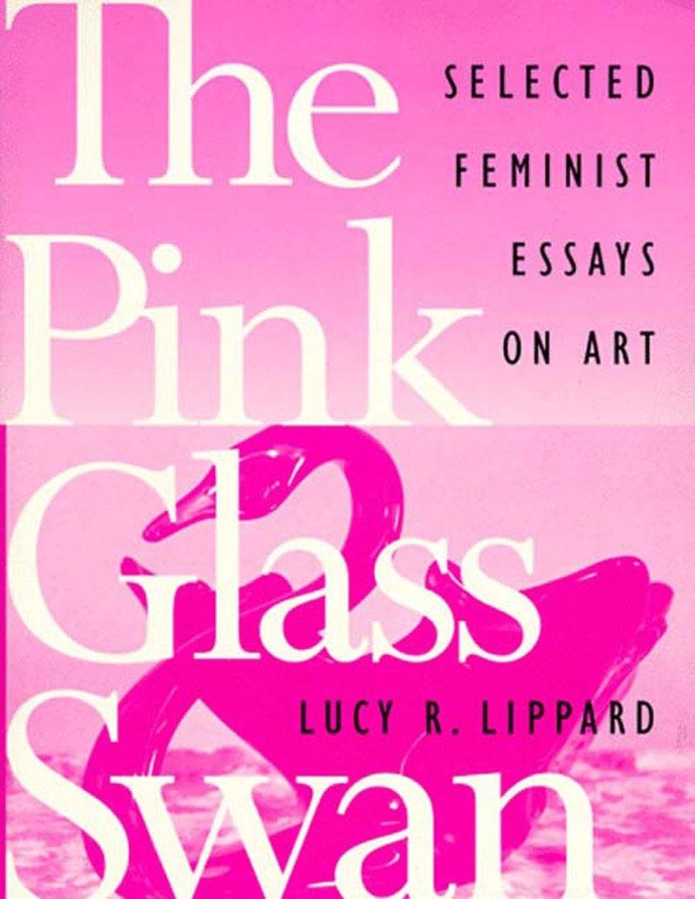
The Pink Glass Swan. Selected feminist essays on art.
Published in 1995, by the New Press
Selected writings over two decades from America's leading feminist art critic.
A semiautobiographical account of the early days of the feminist art movement
Traces Lippard’s thinking on such topics as
the ever-evolving definitions of "women's art",
political and activist art,
the contributions of feminist art theory to the politics of identity

Slide 10
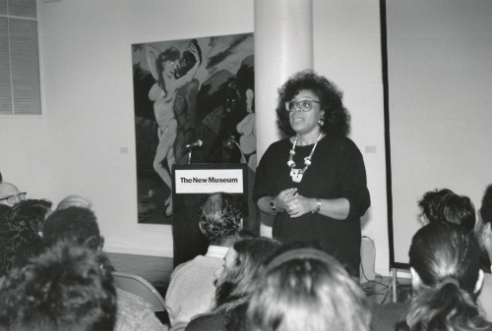
Lowery Stokes Sims
Since the 1970s she has given the opportunity for artists involve with the black art movement, the feminist art movement and the politics of postmodernism and beyond
While working for MMoA she helped build the museum's collection by adding works by different African –American artists
Not just a great curator for African-American work, but a well-respected curator of any genre
“African-American artists who are growing are going to need to be nurtured. That’s essentially what we have to do, and despite the much-vaunted concept of globalism, I personally feel we all still need a sense of our uniqueness on this planet [...] ”
Lowery Stokes Sims
Retired Curator at the museum of Arts and Design
Education and curatorial staff of the Metropolitan Museum of Arts (1972- 1999) where she curated over 30 exhibitions
Specialised in modern and contemporary Art best known for her particular experience in the work of African, Latino and Asian –American artists.
She has lectured and guest cuarted exhibitions nationally and internationally

Slide 11
Art and Race Matters, the career of Robert Colescott
Contemporary Arts Centre , September 20, 2019 through January 12, 2020
“His perspectives on race, life, social mores, historical heritage and cultural hybridity allow us to forthrightly confront what the state of global culture will be in the immediate future.”
Curator Lowery Stokes Sims
The exhibition is accompanied by a catalogue highlighting Colescott’s extensive career published by Rizzoli Electa and will be touring several museums around the United States all facilitated by the CAC.
85 total works throughout 53 years of Colescott’s career that both bring to the surface and challenge diversity and racial stereotypes

Slide 12
Key area of Interest – Cultural Paradigm Shifts
​Culture Change / Paradigm Shifts
- occur when the people within a cultural group, all experience a change in their beliefs or their perspective on the world due to new information or experiences.
Internet
Internet impact on society is now making economic, social, and political changes around the globe, It helps spread and receive information. In the same time it has radically changed for example the field of art, especially in its production, distribution and reception
Gender Tolerance
The diversity of genders is becoming more visible in the streets, online and in our mainstream media. In the same time there is also a counter effect that manifests in a rise in homophobia and transphobia that we can see almost everyday in the newspaper
Feminism
A paradigm that has been taken under consideration a while ago, incorporates the position that societies prioritize the male point of view, and that women are treated unfairly. Efforts to change that include fighting gender stereotypes and seeking to establish educational and professional opportunities for women that are equal to those for men.
Race Tolerance
This paradigm shapes our understanding of what race and racism mean and the nature of our discussion about race. Anti-racism for example promotes an egalitarian society in which people are not discriminated against on the basis of race.
Notes:
we are becoming more tolerance and open minded towards people in general , all the LGBTq+ rights are being considered by governments , some people still can not accept how someone can identify gender with personality , but societies are changing and people finally after centuries are becoming more aware that every person has the same rights and is equal.
wouldnt be treated on the same level as men, in some spectrums women are still treated in a different way than men , sometimes its hard to notice that , because of the habit that societies have adapt ,which is why we still have to underline and speak about same human rights
The impact of the technology on everyone’s life , on art , how the internet changed the way in which we are learning , how we gets inspirations , we know more about different fashions , about different cultures , we have bigger spectrum of technics , we can communicate with different countries , we can learn from them , be more social , more understanding etc..
Racism
the matter of race , it got to our culture as a tolerancy (again) but becaue of the fact that it used to be sop stporng in our history (specioally American history) it came to the culture nowadays , obviously racism is a horrible thing that cause dlots of pain and deaths ,but somwtimes we can not just over lap something and we haave to accept the culture that different racfes created , the Robert colescott not otnly captured the racism in his art but also shown the absurd of it in a funny way ,maybe by using a black humor but still , not sad way

Slide 13

3 key questions
1. Do cultural paradigm shifts have any impact on Art?
2. What impact does Art have on society?
3. How does Art help to understand different changes/paradigm shifts in the society? Does it at all?

Slide 14
Conclusion what I have gained form the research:
Have learned a lot about tolerance
Curators work
To explore different societies problems
To gain knowledge
To be open minded

Slide 15
Bibliography
https://www.linkedin.com › lowery-sims-2b255422
https://en.wikipedia.org › wiki › Lowery_Stokes_Sims
https://art.arts.uci.edu › lowery-stokes-sims
https://www.encyclopedia.com/education/news-wires-white-papers-and-books/sims-lowery-stokes-1949
https://www.artnews.com/art-news/news/i-was-really-a-nerd-lowery-stokes-sims-at-arttables-2017-benefit-8194/
http://www.chebucto.ns.ca/Government/IndustryCanada/cat.html
https://www.jstor.org/stable/3481059?seq=3#metadata_info_tab_contents
https://hyperallergic.com/521260/lowery-stokes-sims-interview/
https://en.wikipedia.org/wiki/Racism#Anti-racism
https://www.evarespini.com/
https://www.gsd.harvard.edu/person/eva-respini/
https://www.curatorialleadership.org/participants/ccl-program/eva-respini/
https://post.at.moma.org/profiles/37-eva-respini
http://photographmag.com/news/eva-respini-moves-to-bostons-ica/
https://yalebooks.yale.edu/book/9780300228250/art-age-internet-1989-today
http://moussemagazine.it/art-age-internet-1989-today-ica-boston-2018/
https://www.icaboston.org/exhibitions/art-age-internet-1989-today
Images in order:
https://www.google.com/url?sa=i&source=images&cd=&cad=rja&uact=8&ved=0ahUKEwjE6KPfjKfmAhXLgVwKHXcODR4QMwhGKAIwAg&url=https%3A%2F%2Fwww.curatorialleadership.org%2Fparticipants%2Fccl-program%2Feva-respini%2F&psig=AOvVaw1J_zemkK_2oaRgYeDkJhdO&ust=1575930502281016&ictx=3&uact=3
https://www.google.com/url?sa=i&source=images&cd=&cad=rja&uact=8&ved=0ahUKEwjlnYznjafmAhULHcAKHYzMBZYQMwhGKAIwAg&url=https%3A%2F%2Fwww.evarespini.com%2F&psig=AOvVaw1KL5iBGCgE1gRAAGKSjXYZ&ust=1575930786976221&ictx=3&uact=3
https://www.google.com/url?sa=i&source=images&cd=&cad=rja&uact=8&ved=0ahUKEwjy6syCjqfmAhUSoVwKHRFNAcAQMwhEKAAwAA&url=https%3A%2F%2Fwww.artmap.london%2Farticle%2Finterview-with-draf-s-vincent-honore-director-and-chief-curator&psig=AOvVaw27DUBxMQxB6n2QVHbCDyy3&ust=1575930844656346&ictx=3&uact=3
https://www.google.com/imgres?imgurl=https%3A%2F%2Fcuratorsintl.org%2Fimages%2Fassets%2F1_VH.JPG&imgrefurl=https%3A%2F%2Fcuratorsintl.org%2Fposts%2Fphotos-from-the-event-vincent-honore&docid=rqBafT1nh4dPPM&tbnid=8MprkZpwX5JfuM%3A&vet=10ahUKEwid1YSXjqfmAhXbh1wKHZAbD3wQMwhbKAcwBw..i&w=600&h=450&bih=932&biw=929&q=vincent%20honore%20in%20agllery&ved=0ahUKEwid1YSXjqfmAhXbh1wKHZAbD3wQMwhbKAcwBw&iact=mrc&uact=8

